Slide 1
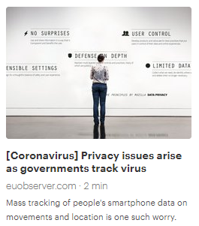
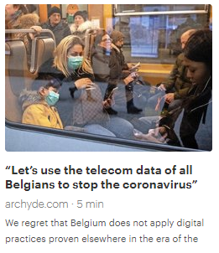
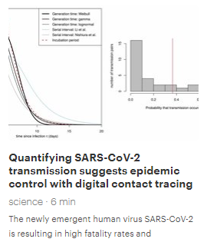
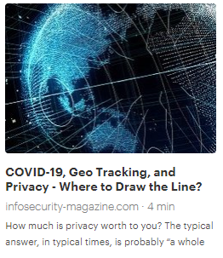
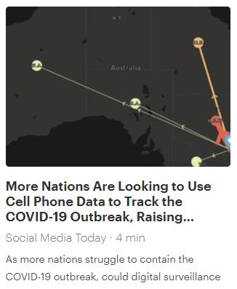
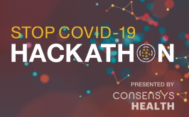

PLOT
Private Location Tracking
https://www.archyde.com/lets-use-the-telecom-data-of-all-belgians-to-stop-the-coronavirus/
https://euobserver.com/coronavirus/147828
https://science.sciencemag.org/content/early/2020/04/09/science.abb6936
https://www.infosecurity-magazine.com/opinions/covid19-geo-tracking-privacy/
https://www.socialmediatoday.com/news/more-nations-are-looking-to-use-cell-phone-data-to-track-the-covid-19-outbr/574695/
Notes:
During the last few months, while the COVID-19 pandemic was spreading over the entire world, we’ve started to see lots of press articles, showing the temptation for authorities to deploy global geolocation tracking systems, in order to fight against the pandemic.
We feel very concern about how these systems threaten the privacy of individuals and would open the door for excessive usage/exploitation of this massive private data collection.
Our contribution to STOP-COVID-19 hackathon is a technical proposal and a prototype for a solution that would give the expected benefits of a global geolocation tracking system, but preserving as much as possible the individual privacy.
We called it PLOT, standing for Private Location Tracking

Slide 2
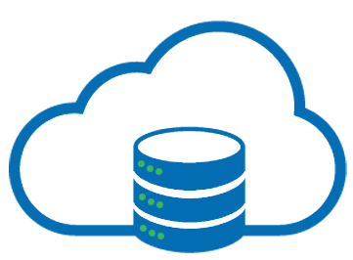
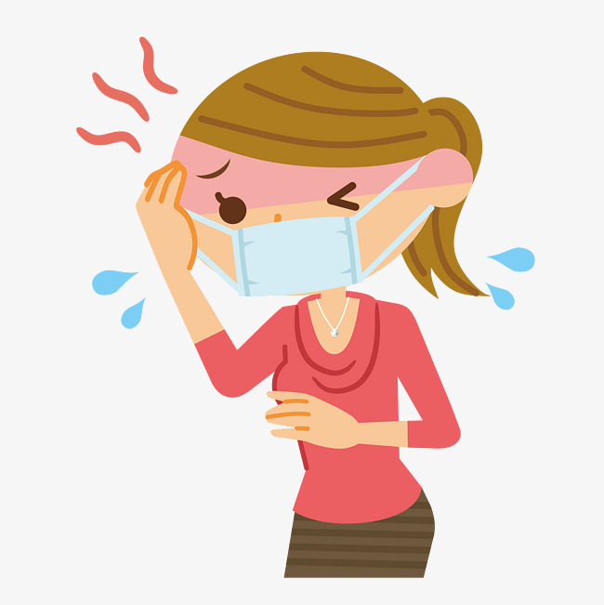



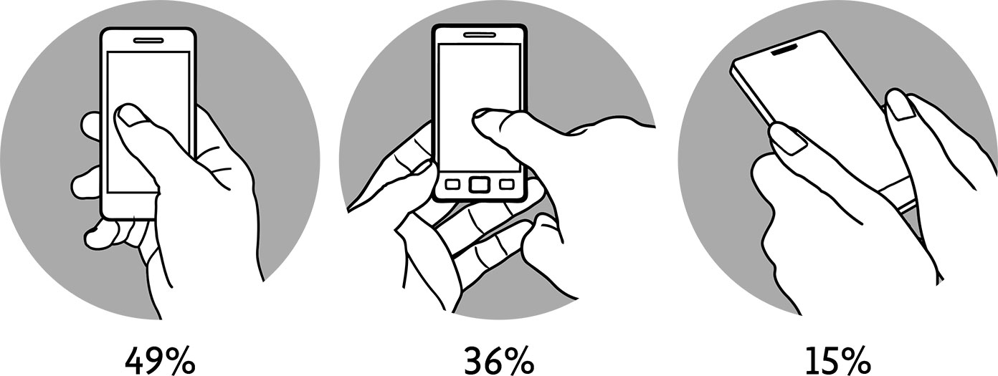
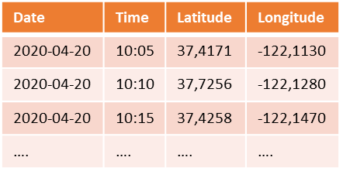
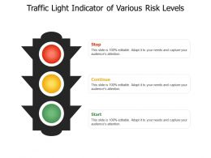
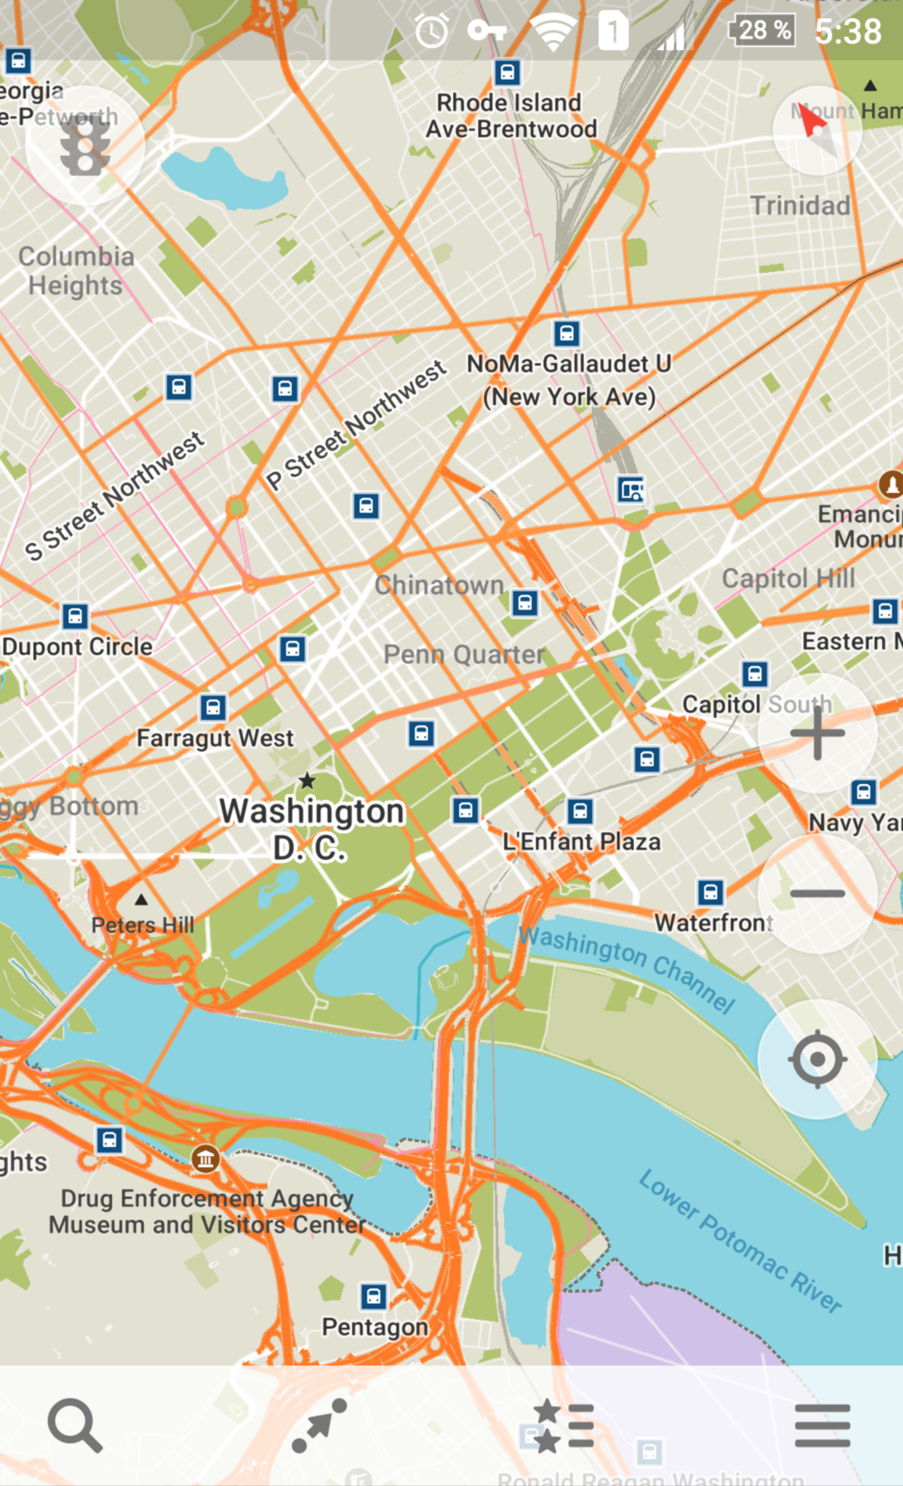

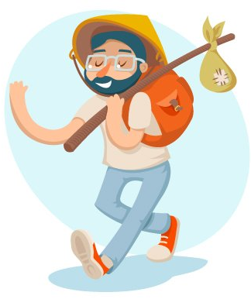
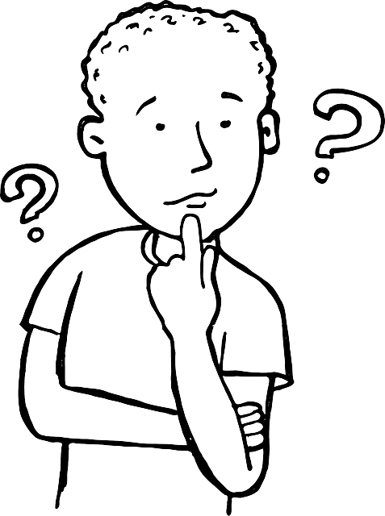
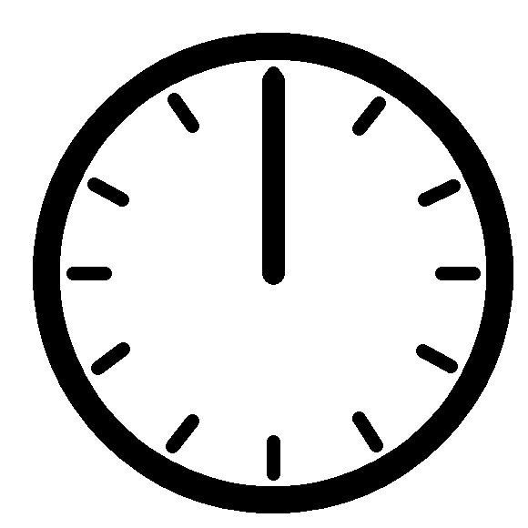
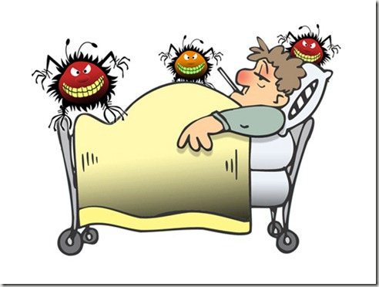
General application concept
PLOT
Locations record
Publish
Check
Date | Time | Latitude | Longitude
2020-04-20 | 10:05 | 37,4171 | -122,1130
2020-04-20 | 10:10 | 37,7256 | -122,1280
2020-04-20 | 10:15 | 37,4258 | -122,1470
…. | …. | …. | ….
Date | Time | Latitude | Longitude
2020-04-20 | 10:05 | 35,4552 | -121,4547
2020-04-20 | 10:10 | 35,7256 | -122,1282
2020-04-20 | 10:15 | 37,4258 | -122,1470
…. | …. | …. | ….
Notes:
The general application concept is as follow:
An APP on smartphone is in charge of collecting location of people, in real-time.
Say, one day, an individual is made aware of his infection by the disease.
We may suspect this person being infectious for people he has contact with in the past days.
So we ask him to publish its location record for the last 15 days into a global database.
As a result, the global database is an aggregation of locations of infected people over time.
Hence, it allows anyone to check if he was at the same location at the same time than an infected person.
It results an evaluation of the risk for him to have been infected in the last days.
In case this risk is significant, this person would limit its social contact to reduce the risk of transmission as soon as possible, and he would take appropriate measures to preserve its own health.

Slide 3
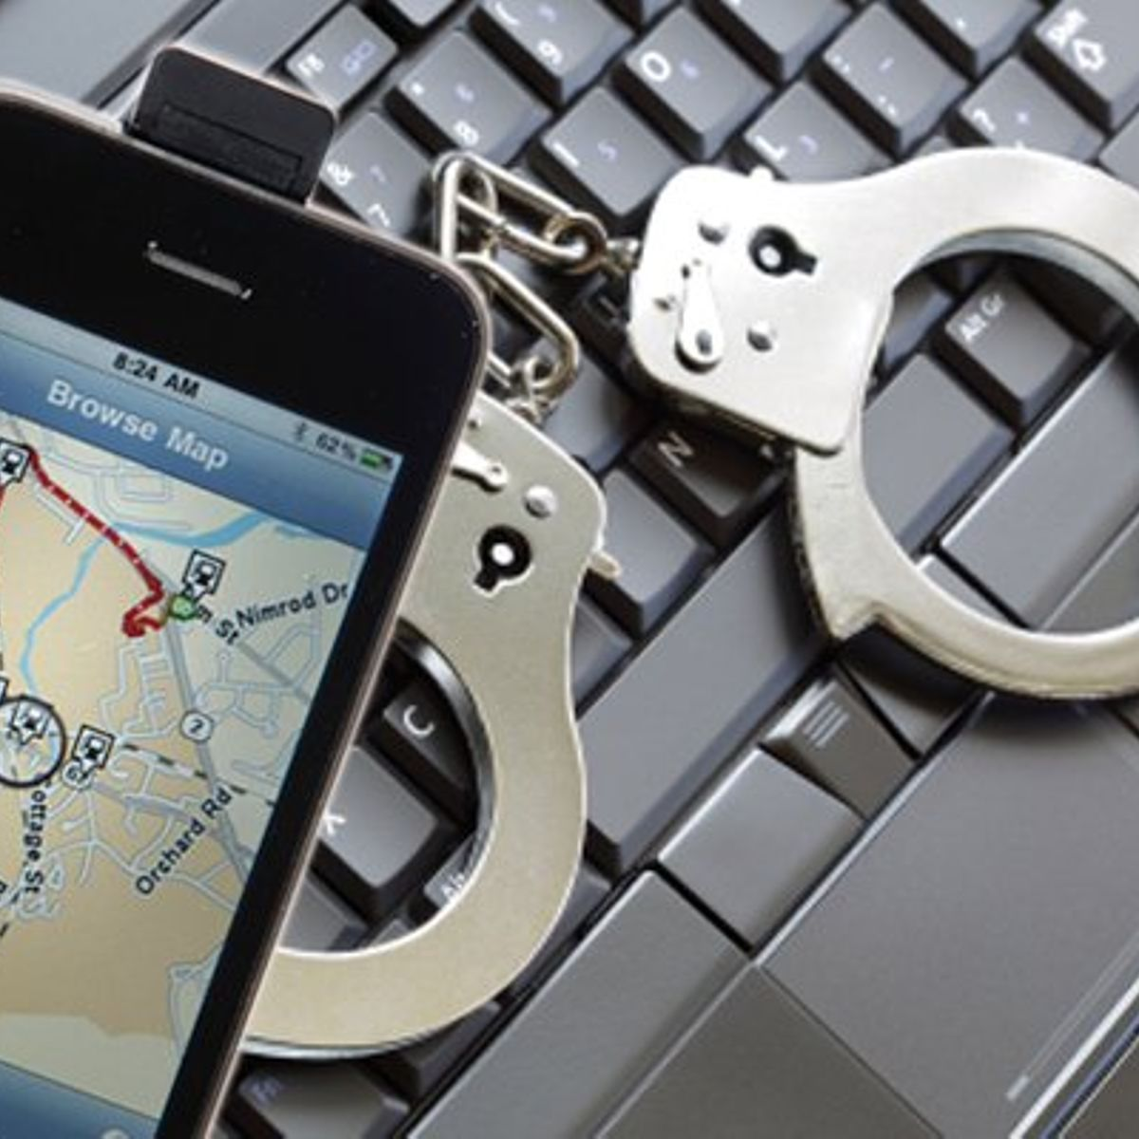
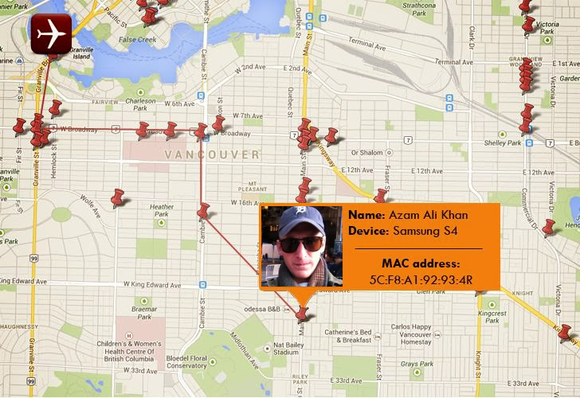


The Problem: Preserving Individual Privacy
PLOT
PLOT
4 PRIVACY GUARDS
Notes:
But, there is a problem
Without any precaution, such a system would publicly reveal the personal locations of infected individuals over time.
Anonymizing the records is not satisfying, because it would still be easy to identify people, using correlation with their home addresses, workplaces, etc.
However, if such a system is centrally controlled, it would mean that the authorities are now able, and allowed, to track people and this is a serious threat against the freedom of movement, one of the key human right.
Hence, the PLOT system implements a sequence of privacy guards to maximize the protection of the personal data, and prevent from any drift toward totalitarian trends.

Slide 4

Privacy Guard #1
PLOT
1. LOCATIONS FILTER
Locations record
Filtered Locations record
Date | Time | Latitude | Longitude
2020-04-20 | 10:05 | 37,4171 | -122,1130
2020-04-20 | 10:10 | 37,7256 | -122,1280
2020-04-20 | 10:15 | 37,4258 | -122,1470
…. | …. | …. | ….
Date | Time | Latitude | Longitude
2020-04-20 | 10:05 | 37,4171 | -122,1130
2020-04-20 | 10:10 | 37,7256 | -122,1280
2020-04-20 | 10:15 | 37,4258 | -122,1470
…. | …. | …. | ….
Notes:
First guard:
The app is designed to keep location record locally only until the user decides to publish it when he’s diagnosed infected.
But, in addition, he can consult the record and choose to remove some explicit locations from the record before the publication.
For instance, the home location can be filtered out from the record, in order to prevent anyone to identify the infected individual by checking the infection status of his personal address.

Slide 5


Privacy Guard #2
PLOT
2. IRREVERSIBLE ENCRYPTION
Filtered Locations record
Encrypted Locations record
Date | Time | Latitude | Longitude
2020-04-20 | 10:05 | 37,4171 | -122,1130
2020-04-20 | 10:10 | 37,7256 | -122,1280
2020-04-20 | 10:15 | 37,4258 | -122,1470
…. | …. | …. | ….
Cypher Data
D147C408 F2E4AA05 18D054F8 94F6D458
9E435B84 5AA8D384 B68F320F 7B4765AC
….
Notes:
Second guard: the data is irreversibly encrypted before publication.
The idea is to encrypt the location information about ‘where the user was at which time’ using an encryption key, whose the corresponding decryption key has been destroyed.
This encryption key is public. However it can only be used to encrypt, not to decrypt.
Once encrypted, the data can not reveal the information about ‘who’, ‘where’ nor ‘when’.
However, because the decryption key has been destroyed, no one can decrypt the data back.
This guard prevents from any unexpected exploitation in case of data leaks from the global database.
It even allows to publish the data on a public ledger, eventually decentralized.

Slide 6
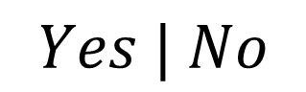
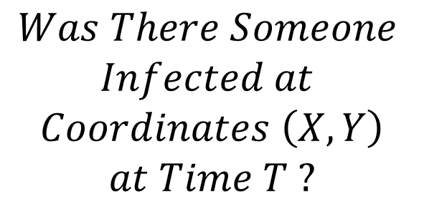
Privacy Guard #3
PLOT
3. BLOOM FILTERING
$$Was There Someone$$
$$Infected at$$
$$Coordinates \left(X,Y\right)$$
$$at Time T ?$$
Encrypted Locations record
Bloom Filter
Cypher Data
D147C408 F2E4AA05 18D054F8 94F6D458
9E435B84 5AA8D384 B68F320F 7B4765AC
….
$$Yes | No$$
Notes:
The third guard we’ve implemented is called ‘Bloom filtering’
The encrypted location data are hashed by different hash functions and the results are mapped across a table of N bits: this data structure is known for being efficient in looking whether an element is present in a set.
Using this table, it’s possible to ask, given a location and a time, whether there was someone infected at the same place at the same time.
When encoded into a bloom filter, it’s not possible to get back to the initial data from the result mapping.

Slide 7
Privacy Guard #4
PLOT
4. DATA MERGING
Global Infection Record
Bloom Filter
Publish
Notes:
The fourth and last guard is ‘data merging’.
Data merging means that the global database, that is publicly available, doesn’t keep information ‘per user’, but only keeps aggregated results.
So if it’s possible to know whether there was someone infected at some location at some time, it’s not possible to know who.
This again prevents from unexpected exploitation of data.

Slide 8
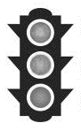
Infection Risk Check
PLOT
Global Infection Record
Check
Number of potential contacts with an infected person:
Locations record
Date | Time | Latitude | Longitude
2020-04-20 | 10:05 | 35,4552 | -121,4547
2020-04-20 | 10:10 | 35,7256 | -122,1282
2020-04-20 | 10:15 | 37,4258 | -122,1470
…. | …. | …. | ….
ENCRYPTION
Bloom Filter
2
Infection risk level:
BLOOM FILTERING
low
Notes:
Now let’s see how the check usecase works.
Given a user that doesn’t know whether he is infected or not,
Using the application, he can launch a check.
The ‘check’ locally creates the bloom filter structure from his individual location record.
Then, it downloads the global infection record, that is publicly available and compute a comparison to detect how many potential contact the user have had in the last days with infectious people.
The resulting number gives an idea of the risk the user has to have been infected in the near past days.

Slide 9
Architecture Overview
PLOT
PLOT App
PLOT Server
Record locations
Merge Individual record into global record
Publish Location Record
of infected user
Post Bloom filter
Filter locations
Encrypt locations
Get global record
Update global record
Decentralized Storage Service
Compare Location Record with global record
Compute Bloom Filter
Store and distribute global record
Get global record
Notes:
Now let’s see a quick overview of the application architecture.
We define 3 parts:
The smartphone application
A centralized server
A decentralized storage area
The smartphone application is in charge of most of the treatments, in a way that the individual data stay on his device as most as possible. The data only left the device in the shape of a bloom filter, after applying the privacy guards we’ve presented before.
The centralized server is in charge of merging the individual data into a global record.
Then he’s publishing or updating the global record on a decentralized storage service, so that he’s made available publicly for other users that would need to check their infection status..

Slide 10
Demo
PLOT
LOCATIONS FILTER
PUBLISH LOCATION RECORD
CHECK INFECTION STATUS
Notes:
The demo is not ready yet.
But here is what we would like to show running on the submission deadline:
The first one is about the location filtering.
The second one is about the publication of the record by an infected individual.
The third one is about checking the infection status of another individual (presumed not-infected).

Slide 11

Outcomes
PLOT
PRIVACY vs FEATURES
Privacy-protection maximalist solution:
Users can still decide to remove locations from their published data
Very limited data analysis potential:
Number of locations infected each day
Number of infected people each day
CENTRALIZATION
Not a fully-decentralized solution (yet)
Centralized service still required to merge the individual data.
Full-decentralized approach (smart contracts): transparent transactions/data, reducing privacy protection level
Potential solution: using secret contract (Enigma layer 2 platform)
Notes:
So, what are the outcomes of our project ?
First, we have deliberately chosen to orient our proposal in such a way that we maximize the privacy protection. That means the features are limited to what is absolutely required and doesn’t threaten individuals privacy.
The second outcome is regarding the decentralization of the solution.
We attempted to implement a complete decentralized solution, but we’ve faced some issues that would lead us to include a centralized service in the architecture.
That is because the ‘data merging’ supposes that someone is in charge of aggregating data from individual users.
If using a smart contract on blockchain, then each transmission of an individual’s personal record (even encrypted) becomes public, so that aggregating the data is useless, because every individual data would remain visible.
An alternative, would be to consider using a secret contract on the Enigma platform to keep these transaction private.

Slide 12

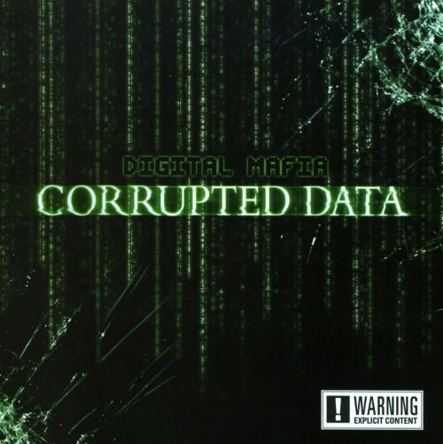









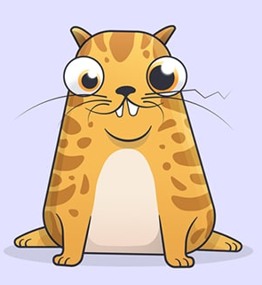

Further Development Ideas
PLOT
PREVENTION of ABUSES
INCENTIVIZE USERS
Check
Publish
Not-infected user
Notes:
To conclude, here are some further development ideas.
One remaining vulnerability we’ve identified in our system is how to prevent malicious people to publish their location records without being diagnosed as infected.
This would lead to saturate the global infection record with false infected zones and would drastically cut down the system’s efficiency.
A possible solution would involve trusted actors (doctors, hospitals, nurses, …) to authorize an individual to publish his record.
Finally, an improvement we’ve identified would be to incentivize people to check their infection risk level periodically (every day), in order to raise alert and trigger protective measures as soon as possible.
Such incentives could be achieved by a gamification process: each day the user submits a ‘check’, he’s qualifying for a lottery, or something similar.
The prizes could be provided by public or private partners (think about marketing campaigns).
The prizes could also be digital non-fungible tokens (like Gitcoin Kudos, for instance).

Slide 13
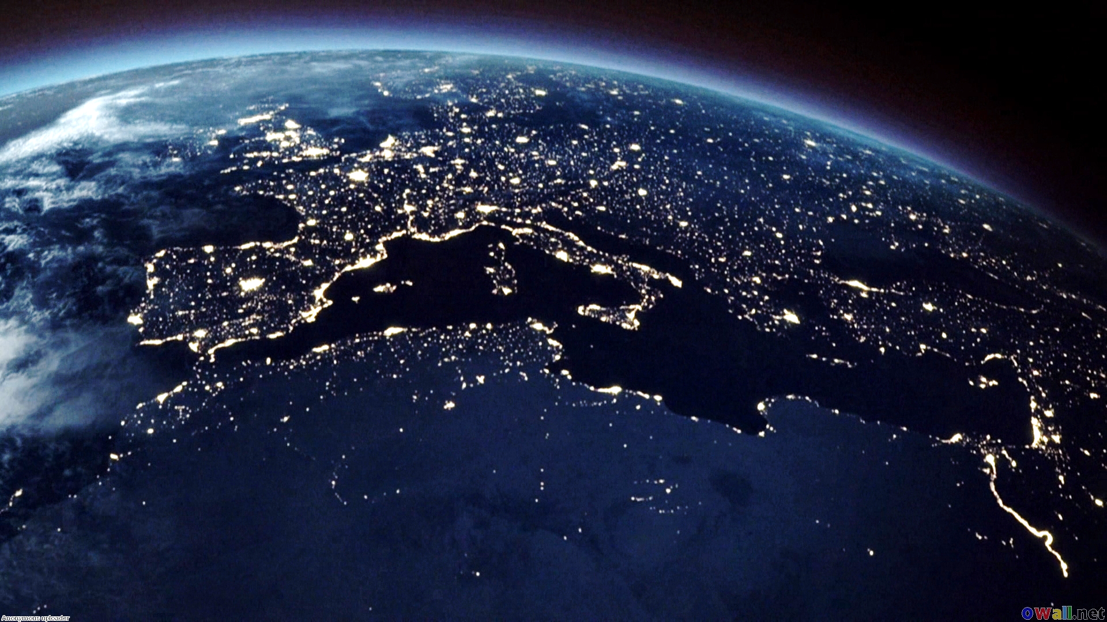
PLOT
Q & A
Thank You For Your Attention
PLOT
Private Location Tracking
Notes:
Thank you for your attention.
Please ask if you have any questions.

